Slide 1
Project Initiation
Lesson 2
Notes:
‹#›

Slide 2
Key Ideas
An opportunity to create business value from using information technology initiates a project.
Feasibility analysis helps determine whether or not to proceed with the IS project.
Projects are selected based on business needs and project risks.

Slide 3
IDENTIFYING PROJECTS WITH BUSINESS VALUE

Slide 4
How Do Projects Begin?
Business needs should drive projects.
Project sponsor recognizes business need for new system and desires to see it implemented.
Business needs determine the system’s functionality (what it will do).
The project’s business value should be clear.

Slide 5
System Request
A document describing business reasons for project and system’s expected value.
Lists project’s key elements
Project sponsor
Business need
Business requirements
Business value
Special issues or constraints
Notes:
The project sponsor prepares a system request
‹#›

Slide 6
System Request Examples
Project sponsor – VP of Marketing
Business need – Reach new customers and improve service to existing customers
Business requirements – Provide web-based shopping capability
Business value - $750,000 in new customer sales; $1.8M in existing customer sales
Special issues or constraints – System must be operational by holiday shopping season

Slide 7
Preliminary Project Acceptance
System request is reviewed by approval committee
Based on information provided, project merits are assessed.
Worthy projects are accepted and undergo additional investigation – the feasibility analysis.

Slide 8
Your Turn
If you were building a web-based system for course registration,
What is the business need?
What would be the business requirements?
What would be the business value (tangible and intangible)?
What special issues or constraints would you foresee?

Slide 9
FEASIBILITY ANALYSIS

Slide 10
Feasibility Analysis
Feasibility is the measure of how beneficial or practical the development of an information system will be to an organization.
Feasibility analysis is the process by which feasibility is measured.
Creeping Commitment approach to feasibility proposes that feasibility should be measured throughout the life cycle.
Notes:
‹#›

Slide 11
Content of a Feasibility Study
The present organizational system - Stakeholders, users, policies, functions, objectives
Problems with the present system - inconsistencies, inadequacies in functionality, performance,…
Goals and other requirements for the new system - Which problem(s) need to be solved? What would the stakeholders like to achieve?
Constraints - including nonfunctional requirements on the system (preliminary pass)
Possible alternatives - “Sticking with the current system” is always an alternative.
Advantages and disadvantages of the alternatives

Slide 12
Four Tests For Feasibility
Technical feasibility is a measure of the practicality of a specific technical solution and the availability of technical resources and expertise.
Economic feasibility is a measure of the cost-effectiveness of a project or solution.
Operational feasibility is a measure of how well the solution will work in the organization. It is also a measure of how people feel about the system/project.
Schedule feasibility is a measure of how reasonable the project timetable is.
Notes:
Chapter 9 - Feasibility Analysis And The System Proposal
‹#›
Teaching Tips
Emphasize that all candidates should be analyzed according to all of the above criteria.
Students should understand that rarely will any one candidate solution be the most feasible candidate according to all criteria.

Slide 13
Technical Feasibility: Can We Build It?
Is the proposed technology or solution practical?
Do we currently possess the necessary technology?
Do we possess the necessary technical expertise
…and is the schedule reasonable for this team?
Is relevant technology mature enough to be easily applied to our problem?
What kinds of technology will we need?
Some organizations like to use state-of-the-art technology
…but most prefer to use mature and proven technology.
A mature technology has a larger customer base for obtaining advice concerning problems and improvements.

Slide 14
Technical Feasibility: cont.
Is the required technology available “in house”?
If the technology is available:
…does it have the capacity to handle the solution?
If the technology is not available:
…can it be acquired?

Slide 15
Economic Feasibility
Purpose - answer questions such as:
Should we build it?
Is the project justified or worthwhile (i.e. will benefits outweigh costs)?
What is the minimal cost to attain a certain system?
How soon will the benefits accrue?
Which alternative offers the best return on investment?
Difficulties
benefits and costs can both be intangible, hidden and/or hard to estimate
ranking multi-criteria alternatives

Slide 16
Economic Feasibility Cost-Benefit Analysis
Identify costs and benefits
Tangible and intangible, one-time and recurring
Assign values to costs and benefits
Determine Cash Flow
Project the costs and benefits over time, e.g. 3-5 years
Calculate Net Present Value for all future costs/benefits - determines future costs/benefits of the project in terms of today's dollar values
A dollar earned today is worth more than a potential dollar earned next year
Do cost/benefit analysis
Notes:
Chapter 9 - Feasibility Analysis And The System Proposal
‹#›
No additional notes.

Slide 17
Benefits vs Costs
Costs:
Development costs: are one time costs that will not recur after the project has been completed.
Operating costs: are costs that tend to recur throughout the lifetime of the system. Such costs can be classified as:
Fixed costs — occur at regular intervals but at relatively fixed rates.
Variable costs — occur in proportion to some usage factor.
Benefits:
Tangible benefits: are those that can be easily quantified.
Intangible benefits: are those benefits believed to be difficult or impossible to quantify.
Work with people who are most familiar with the area to develop estimates
Intangibles should also be quantified
If intangibles cannot be quantified, list and include as part of supporting material
Notes:
Chapter 9 - Feasibility Analysis And The System Proposal
‹#›
Teaching Tips
Our experience suggests that students will need examples of each. The chapter includes several examples. Try providing the students with a list of items and ask them to classify them as a cost or benefit and to distinguish between the type of cost or benefit.
While students tend to understand intangible benefits, they may have some difficulty in quantifying them. An exercise or two will help to reinforce the fact that intangible benefits can indeed be quantified.

Slide 18
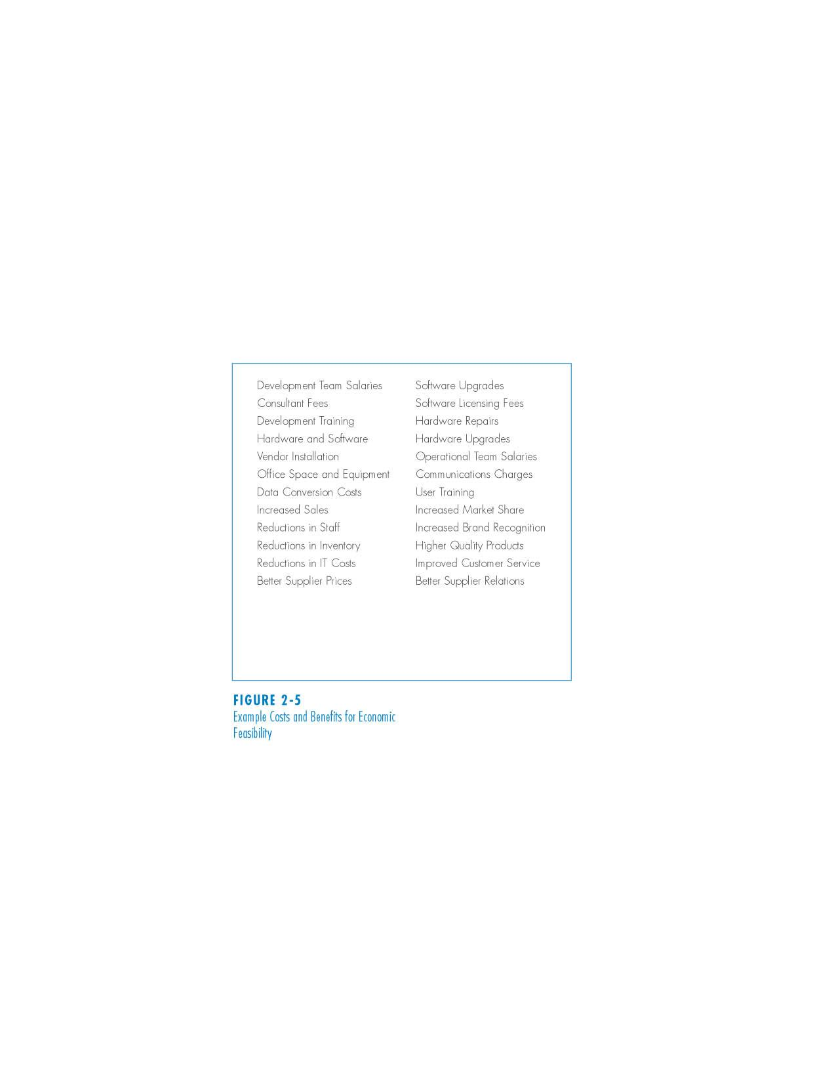
Example Costs and Benefits for Economic Feasibility

Slide 19
Three Popular Techniques to Assess Economic Feasibility
Return On Investment
Net Present Value
Payback Analysis
The Time Value of Money is a concept that should be applied to each technique. The time value of money recognizes that a dollar today is worth more than a dollar one year from now.
Notes:
Chapter 9 - Feasibility Analysis And The System Proposal
‹#›
Teaching Tips
While the textbook covers only the above popular techniques, it is important to stress that there may be others that organizations choose to use in assessing the economic feasibility of an investment.
Stress the importance of determining the investment decision-making process or techniques used by the organization. It should also be pointed out that sometimes the techniques vary according to the individuals involved.

Slide 20
Present Value Formula
PV_{n} = 1/(1 + i)^{n}
Where n is the number of years and i is the discount rate.
E.g. if the discount rate is 12%, then
Present_Value₁ = 1/(1 + 0.12)¹ = 0.893
Present_Value₂ = 1/(1 + 0.12)² = 0.797
The discount rate - measures opportunity cost:
Money invested in this project means money not available for other things.
Benefits expected in future years are more prone to risk.
This number is company- and industry-specific. “what is the average annual return for investments in this industry?”
Notes:
Chapter 9 - Feasibility Analysis And The System Proposal
‹#›
Teaching Tips
While you may want your students to know this formula, be sure to emphasize that PV tables are available!
Point out that the lifetime of an investment may be dictated by an organization and its investment decision makers.
Point out that the interest rate is often dictated. Many companies choose to use the current prime rate.

Slide 21
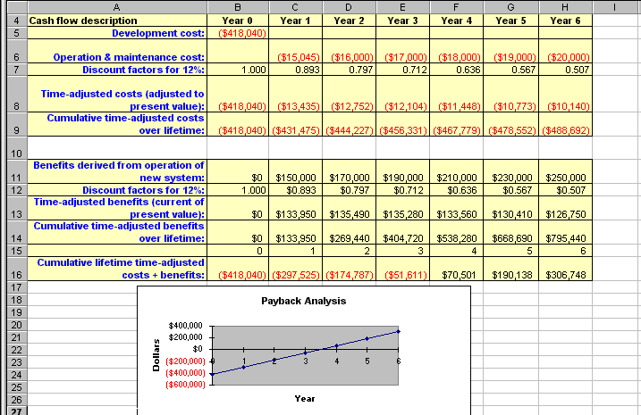
Cost Benefit Analysis: Example
Notes:
Chapter 9 - Feasibility Analysis And The System Proposal
‹#›
No additional notes.

Slide 22
Net Present Value (NPV)
NPV Measures the total value of the investment, with all figures adjusted to present dollar values
NPV = Cumulative PV of all benefits - Cumulative PV of all costs

Slide 23
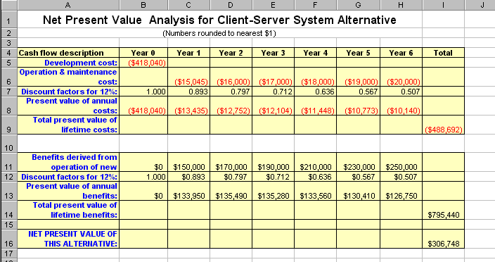
Net Present Value (NPV) Analysis
Notes:
Chapter 9 - Feasibility Analysis And The System Proposal
‹#›
No additional notes.

Slide 24
Return-on-Investment Analysis (ROI)
Return-on-Investment compares the lifetime profitability of alternative solutions or projects.
The ROI for a solution or project is a percentage rate that measures the relationship between the amount the business gets back from an investment and the amount invested.
Notes:
Chapter 9 - Feasibility Analysis And The System Proposal
‹#›
No additional notes.

Slide 25
ROI Formulas
Lifetime ROI is calculated as follows:
ROI = Estimated lifetime benefits - Estimated lifetime costs x 100
Estimated lifetime costs
or:
ROI = (Net Present value / Estimated lifetime costs) x 100
For our example
ROI = (795,440 - 488,692) / 488,692 = 63%,
or
ROI = 306,748 / 488,692 = 63%
Annual ROI = lifetime ROI / lifetime of the system
Solution with the highest ROI is the best alternative
But need to know payback period too to get the full picture
E.g. A lower ROI with earlier payback may be preferable in some circumstances
Notes:
Chapter 9 - Feasibility Analysis And The System Proposal
‹#›
No additional notes.

Slide 26
Computing the Payback Period
Can compute the break-even point:
How long before the project’s returns match the amount invested
When does lifetime benefits overtake lifetime costs?
The longer it takes to break even, the higher the project’s risk.
Determine the fraction of a year when payback actually occurs:
| beginningYear amount |
endYear amount + | beginningYear amount |
For our last example, 51,611 / (70,501 + 51,611) = 0.42
Therefore, the payback period is approx 3.4 years

Slide 27
Operational Feasibility If we build it, will they come?
Strategic alignment
How well do the project goals align with business objectives?
How do end-users and managers feel about…
The problem you identified?
The alternative solutions you are exploring?
You must evaluate:
Not just whether a system can work…
… but also whether a system will work.

Slide 28
Feasibility Analysis Matrix
Feasibility Analysis Matrix is intended to complement the candidate systems matrix with an analysis and ranking of the candidate systems.
Candidate 1 Name
Candidate 2 Name
Candidate 3 Name
Description
Operational
Feasibility
Technical
Feasibility
Schedule
Feasibility
Economic
Feasibility
Ranking
Notes:
Chapter 9 - Feasibility Analysis And The System Proposal
‹#›
No additional notes.

Slide 29
Operational Feasibility cont.
Any solution might meet with resistance:
Does management support the project?
How do the end users feel about their role in the new system?
Which users or managers may resist (or not use) the system? People tend to resist change.
Can this problem be overcome? If so, how?
How will the working environment of the end users change?
Can or will end users and management adapt to the change?

Slide 30
Schedule feasibility
How long will it take to get the technical expertise?
We may have the technology, but that doesn't mean we have the skills required to properly apply that technology.
May need to hire new people
Or re-train existing systems staff
Whether hiring or training, it will impact the schedule.
Assess the schedule risk:
Given our technical expertise, are the project deadlines reasonable?
If there are specific deadlines, are they mandatory or desirable?
If the deadlines are not mandatory, the analyst can propose several alternative schedules

Slide 31
Schedule feasibility cont.
What are the real constraints on project deadlines?
If the project overruns, what are the consequences?
Deliver a properly functioning information system two months late…
or deliver an error-prone, useless information system on time?
Missed schedules are bad, but inadequate systems are worse!

Slide 32
Sample Feasibility Analysis Matrix
Feasibility Criteria
Operational Feasibility
Functionality. A description of to what degree the candidate would benefit the organization and how well the system would work.
Political. A description of how well received this solution would be from both user management, user, and organization perspective.
Technical Feaasibility
Technology. An assessment of the maturity, availability (or ability to acquire), and desirability of the computer technology needed to support this candidate.
Expertise. An assessment of the technical expertise needed to develop, operate, and maintain the candidate system.
Economic Feasibility
Cost to develop:
Payback period (discounted):
Net present value:
Detailed calculations:
Schedule Feasibility
An assessment of how long the solution will take to design and implement.
Ranking
Wt.
30%
30%
30%
10%
100%
Candidate 1
Only supports Member Services requirements and current business processes would have to be modified to take advantage of software functionality.
Score: 60
Current production release of Platinum Plus package is version 1.0 and has only been on the market for 6 weeks. Maturity of product is a risk and company charges an additional monthly fee for technical support.
Required to hire or train C++ expertise to perform modifications for integration requirements.
Score: 50
Approximately $350,000.
Approximately 4.5 years.
Approximately $210,000.
See Attachment A.
Score: 60
Less than 3 months.
Score: 95
60.5
Candidate 2
Fully supports user required functionality.
Score: 100
Although current technical staff has only Powerbuilder experience, the senior analysts who saw the MS Visual Basic demonstration and presentation have agreed the transition will be simple and finding experienced VB programmers will be easier than finding Powerbuilder programmers and at a much cheaper cost.
MS Visual Basic is a mature technology based on version number.
Score: 95
Approximately $418,040.
Approximately 3.5 years.
Approximately $306,748.
See Attachment A.
Score: 85
9-12 months.
Score: 80
92
Candidate 3
Same as candidate 2.
Score: 100
Although current technical staff is comfortable with Powerbuilder, management is concerned with recent acquisition of Powerbuilder by Sybase Inc. MS SQL Server is a current company standard and competes with SYBASE in the client/server DBMS market. Because of this we have no guarantee future versions of Powerbuilder will “play well” with out current SQL Server.
Score: 60
Approximately $400.000.
Approximately 3.3 years.
Approximately $325,500.
See Attachment A.
Score: 90
9-12 months.
Score: 85
85
Notes:
Chapter 9 - Feasibility Analysis And The System Proposal
‹#›
No additional notes.

Slide 33
PROJECT SELECTION

Slide 34
Project Selection Issues
Approval committee works from the system request and the feasibility study
Project portfolio – how does the project fit within the entire portfolio of projects?
Trade-offs must be made to select projects that will form a balanced project portfolio
Viable projects may be rejected or deferred because of project portfolio issues.
Notes:
A project portfolio is a collection of projects, programs and processes that are managed together and optimized for the financial and strategic goals of an organization.
‹#›

Slide 35
The approval committee must be selective about where to allocate resources, because the organization has limited funds.
This involves trade-offs in which the organization must give up something in return for something else in order to keep its portfolio well balanced.

Slide 36
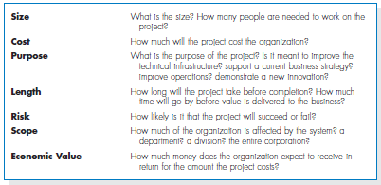
Ways to Classify Projects

Slide 37
Summary
Project initiation involves creating and assessing goals and expectations for a new system
Identifying the business value of the new project is a key to success
Feasibility study is concerned with ensuring that technical, economic, and organizational benefits outweigh costs and risks
Project selection involves viewing the project within the context of the entire project portfolio, and selecting those projects that contribute to balance in the portfolio

Slide 38
Exercise 1
Perform a financial analysis for a project using the format provided on slide 21. Assume the projected costs and benefits for this project are spread over five years as follows: Estimated costs are $100,000 in Year 0 and $25,000 each year in Years 1, 2, 3, and 4. Estimated benefits are $0 in Year 0 and $80,000 each year in Years 1, 2, 3, and 4. Using an 8% discount rate, calculate and clearly display the NPV, ROI, and year in which payback occurs.
In addition, write a paragraph explaining whether you would recommend investing in this project based on your financial analysis.

Slide 39
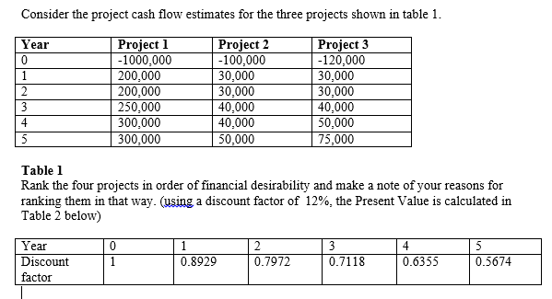
Exercise 2

